Slide 1


Asteroids, the Game
scratch.mit.edu
Warmup:
Review: Controls
Introduce: Clones
Next step: evolution
Wrap up

Slide 2
Today:
Asteroids
We will take a project with some costumes
A space ship
A bullet
An asteroid
Warm up: Change the space ship to rotate and move
Then: A quick review on script blocks.
First improvement: Make more asteroids (using Cloning)
Then: make them move
Second improvement: Add bullets!
Optional improvement: Score on hit (Variables)
Final: Show your project!
Epilogue: Bonus:
http://scratch.mit.edu/projects/16743509

Slide 3
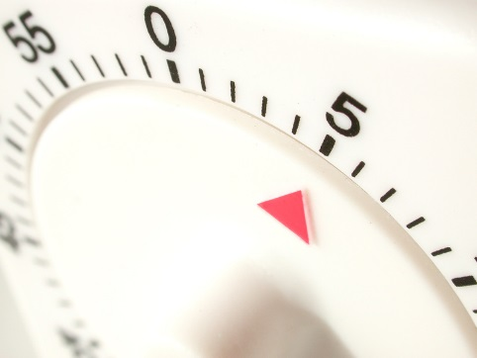
5-minute Warmup! Launch your asteroid game
Go to scratch.mit.edu and sign in if you have an account.
Start with scratch.mit.edu/projects/17772258
Change the background
I chose ‘stars’ from the built-in backgrounds
Make the ship rotate (by 8 degrees) when you press right or left keys

Slide 4
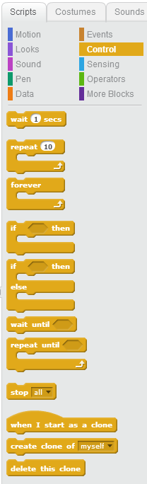
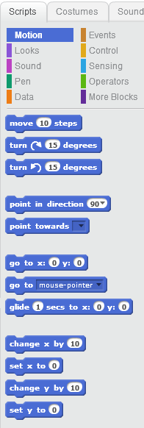
A quick refresher on code blocks
Motion
Control

Slide 5
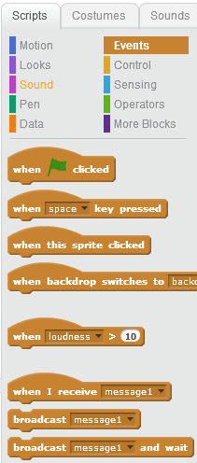
Events
The MOST USEFUL events are
When the Green Flag is clicked
When a keyboard key is pressed
When a sprite is clicked
You can make new Messages as needed

Slide 6
Clones Making more sprites
Clones
Clones
Clones
Some times, you will want several of a thing
You don’t want to have to paint more than one
You don’t want to have to attach script to each one
So, Scratch lets you easily ‘clone’ one of your sprites
We’ll start by cloning the asteroid

Slide 7
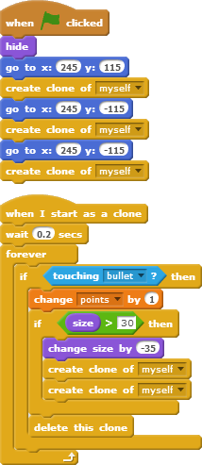
Asteroids – next steps
Asteroid Clones
The game starts with 3 huge asteroids.
If a bullet hits a small asteroid, you Score!!
If a bullet hits a bigger asteroid, it breaks up
If it goes off the screen, it shows up on the other side. Just copy that code from
http://scratch.mit.edu/projects/17450708

Slide 8
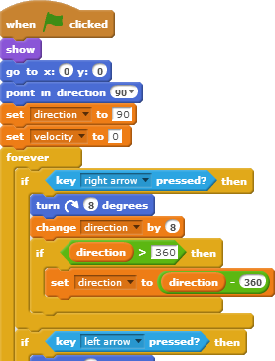
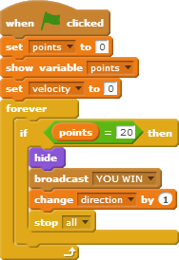
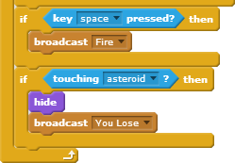
Let’s talk about the space ship
It sets the starting conditions
It handles all key presses (up, down, right, left, space)
It detects if an asteroid hits it.

Slide 9
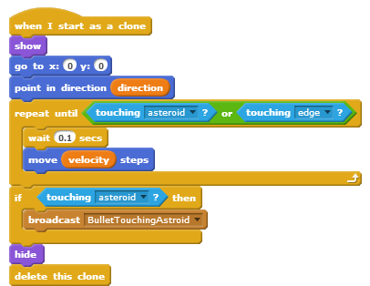
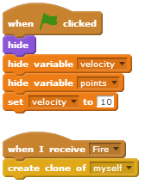
Let’s talk about bullets
It’s easier to start coding with just one bullet, but it’s easier to DIE, too.
Since the space ship does the firing, it can send a message to the master bullet, which receives the Fire message. (below left)
The bullet logic is not easy

Slide 10
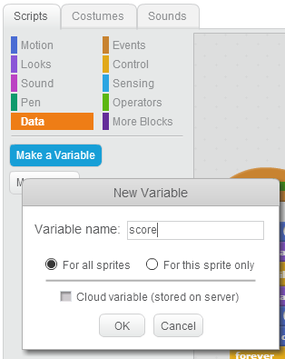
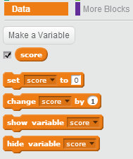
Data. Also called Variables
If you have information that changes, use “variables”
What data might you want?
Smallest change: Add the score (a ‘bounce’ count)
Use the checkbox to have it automatically display
Later, maybe a “lives:” counter

Slide 11
Next steps:
Most games give you multiple lives.
What topics did we cover which would help?
I’m thinking that we might have a variable called “lives”
We set it to ‘3’ on green flag, decrement when the asteroid hits the ship, and send ‘show game over’ when it drops to zero.
How could we ‘refactor’ the code so we can
Restart the game on a mouse click (& change user messages)
We must remove any ‘stop all’
I think I need a new event-message called “Start Game”
I think I could merge all the information sprites (“How to start”, “Game over”) into one sprite. I would make the 2nd costume in the sprite (“Game Over, play again?”)
I think I need a new “Heart Missed” message
I think a 3rd display “You missed. Here’s another heart”
I would put message handlers on that sprite to set the correct costume to match the messages.
I would move nearly all of the existing code in the ‘on Green Flag’ event into a new block (in More Blocks) ‘Start Game’ handler, and have the on green flag handler send a ‘Start Game’ message. (The ‘Show Game Over’ handler / should also

Slide 12
Bonus Material
Who has heard of Flappy Bird?
It got famous last week and was removed from the Apple App Store on Sunday
It’s an incredibly simple game (to write) but it’s difficult to play
At any rate, Scratch has some decent clones
http://scratch.mit.edu/projects/16743509/
http://scratch.mit.edu/projects/16847315/
Did you like this class? Want me to do more after school?

